Slide 1

SMART INDIA HACKATHON 2026
Problem Statement ID – SIH26028
Problem Statement Title - Dynamic Forecast of Expected Time of Arrival (ETA) for Coaching Trains.
Theme - smart automation
PS Category - Software
Team ID- 53
Team Name - lumina

Slide 2
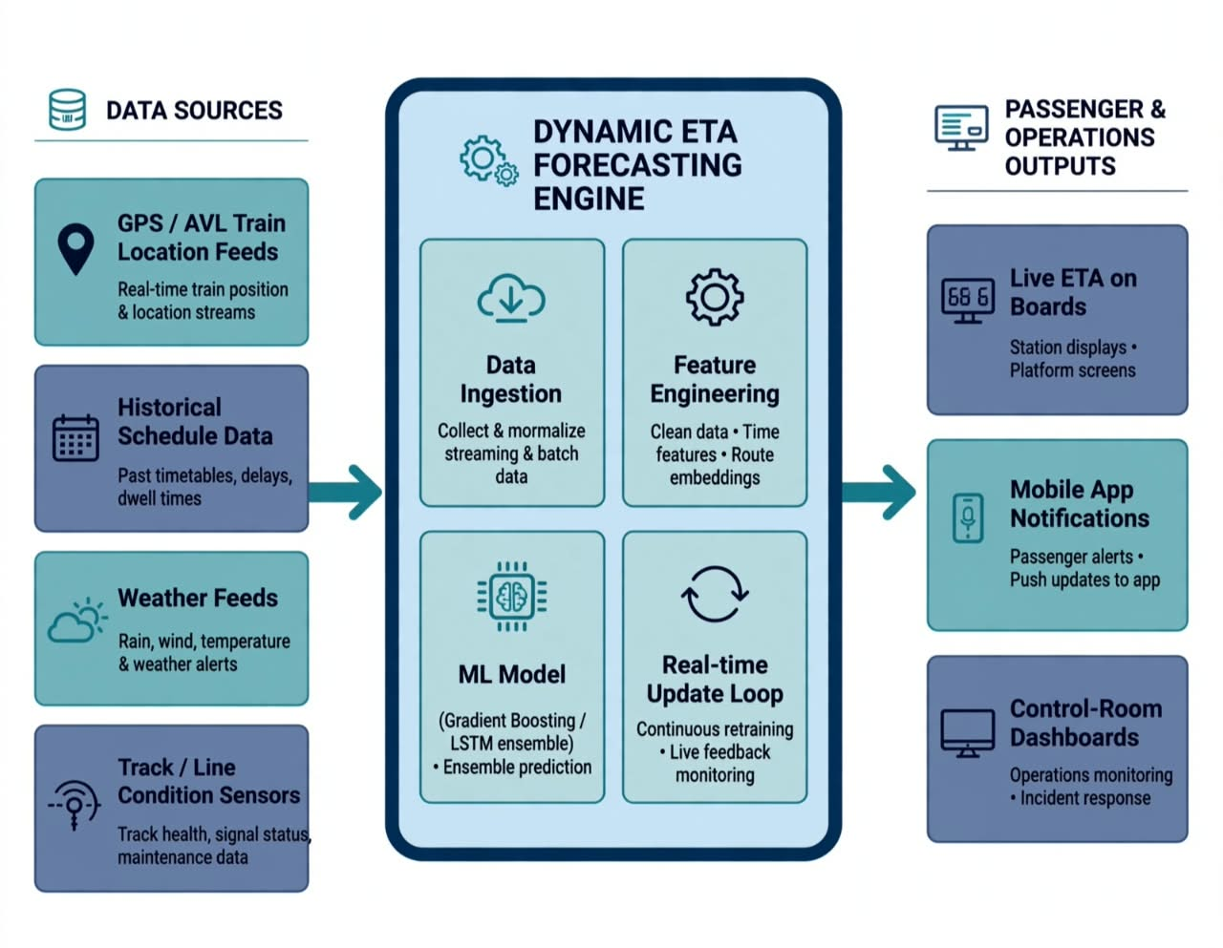
OUR DYNAMIC ETA FORECASTING SYSTEM
LUMINA
1. Data Collection
Current train location.
Current speed and delay.
Previous station timings.
Distance to upcoming stations.
Historical delay patterns.
Weather and route conditions.
Congestion information.
2. Data Processing & Analysis
Clean and combine data from different sources.
Handle missing and incorrect data.
Identify station-wise and route-wise delay patterns.
3. AI/ML-Based Prediction
Learn from historical and real-time train data.
Predict additional future delay.
Forecast how the delay will propagate across upcoming stations.
4. Prediction Output
Station-wise future ETA.
Expected delay at each station.
Dynamic final ETA.
Possible reasons for delay.
What-if analysis.
Unique feature :
Instead of only showing the current running status, our system predicts how the delay may increase or decrease at upcoming stations and at the final destination.

Slide 3
TECHNICAL APPROACH
LUMINA
Collect Data → Train location, speed & delay.
Process Data → Organize current and past data.
AI Prediction → Predict future delay.
Dynamic ETA → Calculate updated arrival time.
Dashboard → Show results to passengers.
↺
─────► NEW LIVE DATA
|
REAL-TIME DASHBOARD Location • ETA
Delay • Next Station
DYNAMIC ETA
ESTIMATION ENGINE
ML PREDICTION
Travel Time + Delay
FEATURE ENGINEERING Distance • Delay Speed • Time
LIVE TRAIN DATA
GPS • Speed • Time
RAILWAY DATA
Timetable • Route
Stations • Distance
HISTORICAL DATA
Past Delays • Travel
Time • Stop Duration
DATA PROCESSING
Cleaning + Combining
TRAIN DATA
DATA PROCESSING
FEATURE ENGINEERING
ML PREDICTION MODEL
DYNAMIC ETA + DELAY FORECAST
REAL-TIME RAILWAY DASHBOARD

Slide 4
FEASIBILITY AND VIABILITY
LUMINA
AREA | VIABILITY
TECHNICAL | Uses available GPS, railway and historical data with ML models.
FINANCIAL | Can be developed using existing software and cloud tools.
OPERATIONAL | Can support railway staff in monitoring delays and planning.
SCALABILITY | Can be expanded to more trains, routes and stations.
PRACTICAL | Provides useful ETA predictions for passengers and Railways.
FEASIBILITY
Low Cost: Uses free and open-source tools.
Easy to Develop: Can be built using existing data and ML technologies.
Scalable: Can be expanded to more trains and routes.

Slide 5
IMPACT AND BENEFITS
LUMINA
Improved Railway Efficiency
Better delay prediction and scheduling.
Reduced Passenger Waiting
Less uncertainty and waiting time.
Better Journey Planning
Reliable ETA for smarter travel decisions.
Data-Driven Decisions
Supports efficient railway operations.
Enhanced Passenger Experience
More reliable and convenient train travel.
Accurate Arrival Information
Passengers know the expected arrival time.
Reduced Waiting Time
Helps passengers avoid unnecessary waiting at stations.
Early Delay Detection
Identifies possible delays before they become major issues.
Better Resource Planning
Helps Railways manage trains and schedules efficiently.
Improved Travel Experience
Makes train journeys more predictable and convenient.
IMPACTS BENEFITS

Slide 6
RESEARCH AND REFERENCES
LUMINA
Train Delay Estimation in Indian Railways by Including Weather Factors Through ML
Research Paper – Bentham Science
Prediction of Train Delay in Indian Railways through Machine Learning Techniques
Research Paper – IJCSE
Data-driven Predictive Model for Dynamic Expected Travel Time Estimation in Rail Freight Networks
Research Paper – ScienceDirect
RailYatri — Train Delay by Train Type: Open the graph/source

